Slide 1
Field Technician Routing & Navigation System

Slide 2
Overview
﻿﻿It stremlinies procesispiniponting customer-reporited network issues.
﻿﻿It collects location data using Link, prioritizes problems, and guides technicians straight to the site using Google Maps, minimizing delays, confusion, and travel time

Slide 3
Key Features
﻿﻿Automatic location data collection
﻿﻿Prioritizaties problems
﻿﻿Geogle Maps integretion
﻿﻿Efficiency improven

Slide 4
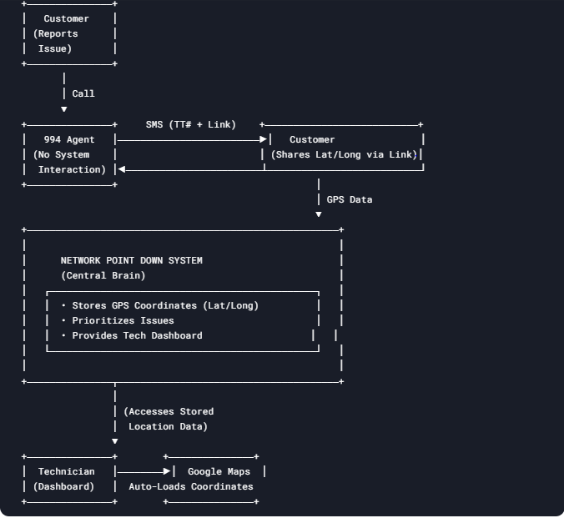
System Model Diagram

